Slide 1
GUVI / IITM · ADVANCED DATA SCIENCE · CAPSTONE PROJECT
Domino's - Predictive
Purchase Order System
Forecasting pizza demand to order the right ingredients, in the right quantity.
91.96%
1,085
64
198.8 kg
Forecast accuracy
Pizzas next week
Ingredients ordered
Total order weight
Sai Naveen Pulivarthi
Domain: Food Service Industry
Notes:
One year of Domino's transaction data, turned into next week's ingredient purchase order. Best model reached 91.96% accuracy.

Slide 2
The Problem
Why ingredient ordering is a real cost problem
Domino's must order perishable ingredients before it knows what will sell.
Order too little and you get stockouts and lost sales. Order too much and fresh stock spoils.
OBJECTIVES
Forecast future pizza sales
Convert that forecast into an ingredient purchase order
BUSINESS VALUE
Inventory
Cost
Forecasting
Supply chain
Stock matched to real demand
Less waste from spoilage
Demand trends inform strategy
Ordering aligned to demand
Domino's - Predictive Purchase Order System
2
Notes:
The deliverable is a purchase order, not just a forecast.

Slide 3
The Data
Two source files covering the whole of 2015
pizza_sales.csv
Pizza_ingredients.csv
One row per pizza sold
Grams of each ingredient per pizza
48,620 rows 12 columns
518 rows 4 columns
THE BUSINESS, IN NUMBERS
49,574
21,350
$817,860
358
91
Pizzas sold
Orders
Revenue
Trading days
Pizza-size variants
Key structure: 32 distinct pizzas are sold in 91 name-and-size variants. Ingredient quantities are defined per variant, not per pizza.
Domino's - Predictive Purchase Order System
3
Notes:
91 variants matters: ingredient grammage is defined per size.

Slide 4
Data Cleaning
70 missing values - every one recovered, none dropped
COLUMN
MISSING
RECOVERY METHOD
OUTCOME
total_price
7
Recomputed as unit_price x quantity
48,620
pizza_category
23
Looked up from pizza_name_id
pizza_ingredients
13
Looked up from pizza_name
of 48,620 sales rows retained
pizza_name
7
Looked up from the ingredient string
Every dropped row is a real sale. Deleting them biases demand downward.
pizza_name_id
16
Rebuilt from (pizza_name, pizza_size)
Items_Qty_In_Grams
4
Mean gram-weight of that pizza
Domino's - Predictive Purchase Order System
4
Notes:
Recovery over deletion: each gap was reconstructed from relationships already in the data.

Slide 5
Data Trap 1 - Two Date Formats in One Column
The single most dangerous defect in this dataset
WHAT THE COLUMN ACTUALLY HOLDS
WHY IT HAPPENS
1/1/2015 days 1-12, d/m/Y
13-01-2015 days 13-31, d-m-Y
A spreadsheet export artefact. Rows where day and month are both 12 or less were silently reformatted; the unambiguous ones were left alone.
The risk
Parsing month-first corrupts every date in the first twelve days of each month - about 40% of the dataset - without raising a single error. The forecast would look plausible and be wrong.
THE FIX
A day-first parser that tries each format in turn -> all 48,620 dates parsed, zero failures
Domino's - Predictive Purchase Order System
5
Notes:
This is the defect most likely to silently ruin the project.

Slide 6
Data Trap 2 - The ID Encodes Size
Why the forecast is built per variant, not per pizza
bbq_ckn_l = Barbecue Chicken + LARGE
pizza_name_id carries both the recipe and the size in one field.
Recovering it
Forecasting on it
The consequence
The 16 missing ids cannot come from the name alone. The (name, size) pair is required.
A large pizza uses more of every ingredient. Forecast by name and the size mix is lost.
Ingredient totals would be quietly wrong - plausible numbers, incorrect order.
Decision: forecast all 91 pizza_name_id variants separately, so each size's grammage multiplies that size's own predicted demand.
Domino's - Predictive Purchase Order System
6
Notes:
Vijay forecast by pizza name (32 series); this project uses 91 variants.

Slide 7
Feature Engineering
Turning raw transactions into modelling features
1
Calendar
2
Holidays
Day of week, month, ISO week, year
US public holiday flag - 9 dates in 2015
3
Promotion
4
Aggregation
Weekend flag, per the project brief
Daily rows rolled up to weekly totals
WHY WEEKLY, NOT DAILY
The purchase order covers one week, so the model should predict the quantity actually being ordered. Weekly aggregation also smooths the day-to-day noise that no forecaster can capture, leaving the trend and seasonality that it can.
Domino's - Predictive Purchase Order System
7
Notes:
Features chosen to match the decision being supported: a weekly order.

Slide 8
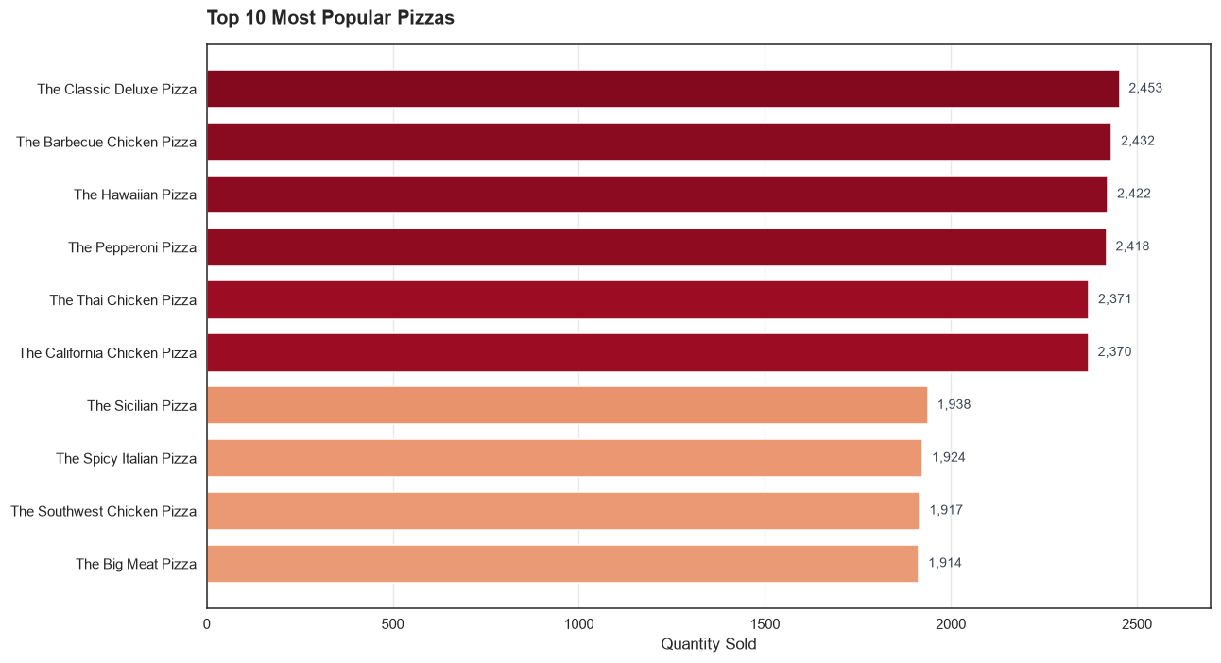
What Sells
Demand is spread flat across the menu
No runaway bestseller
The top five pizzas sit within 3.5% of each other. Ingredient planning has to cover the whole menu, not a handful of stars.
THE OUTLIER
490 units
The Brie Carre Pizza - about a fifth of the leaders, and the only real laggard.
Domino's - Predictive Purchase Order System
8
Notes:
Flat demand means the ingredient bill spans the full menu.

Slide 9
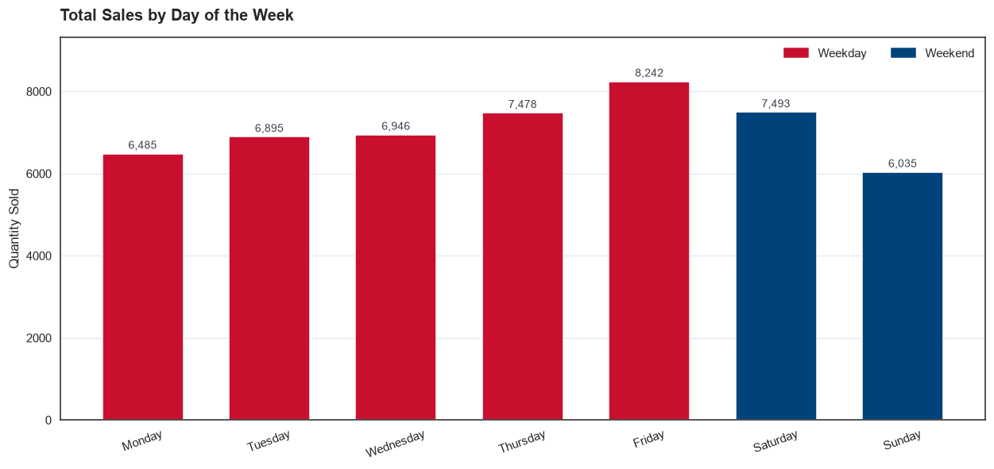
The Weekend Assumption Does Not Hold
A finding that contradicts the project brief
THE BRIEF ASSUMES
Weekends are the promotional period, so weekend demand should be higher.
THE DATA SAYS
130 /day weekend vs 142 weekday
Friday peaks at 165. Sunday is the weakest day of the week. Holidays are the real uplift: 169 vs 138.
Domino's - Predictive Purchase Order System
9
Notes:
Kept the weekend flag because the brief asks for it, but it reads as a weak negative signal, not a promotional uplift.

Slide 10
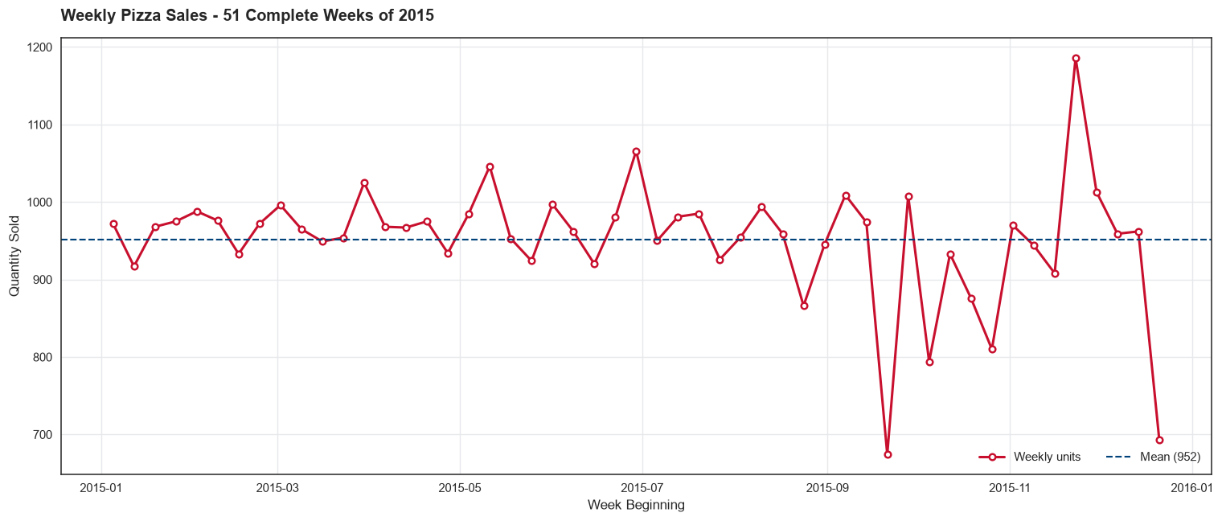
Data Trap 3 - Truncated Weeks at Both Ends
Two buckets that look like demand collapses but are not
THE PROBLEM
2015 starts and ends mid-week. The first bucket holds 4 days (591 units), the last holds 4 days (442) - against a full-week mean of 952.
THE SUBTLETY
Test date-range coverage, not days-with-sales. Christmas Day is a genuine zero-sales day inside a complete week - real demand information worth keeping.
Domino's - Predictive Purchase Order System
10
Notes:
Dropping both truncated weeks improved SARIMA from 0.0852 to 0.0804 MAPE.

Slide 11
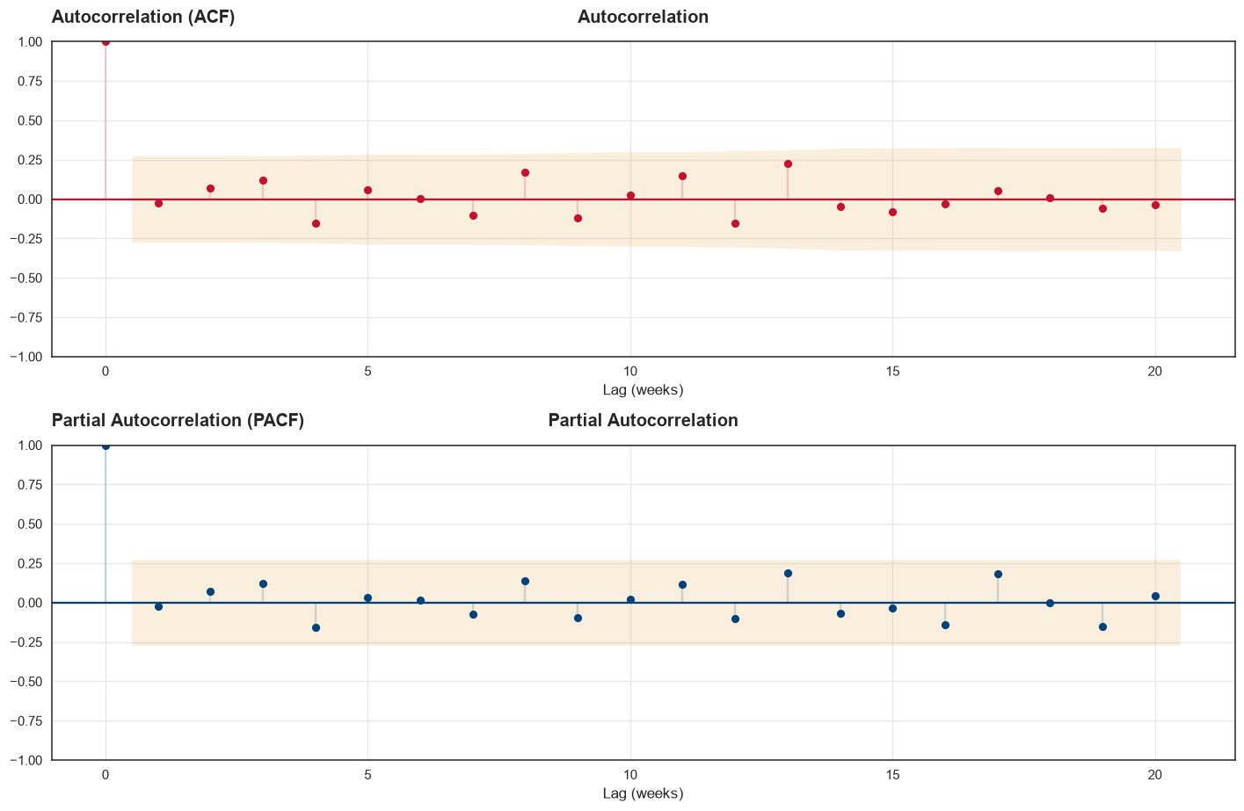
Preparing the Series
Stationarity and the train / test split
Stationarity (ADF)
The Augmented Dickey-Fuller test decides whether differencing is needed before ARIMA can be applied.
ACF / PACF
These guide the choice of the AR (p) and MA (q) terms.
SPLIT - CHRONOLOGICAL
40 train / 11 test weeks
Domino's - Predictive Purchase Order System
11
Notes:
Never shuffled - the model always predicts forward in time, as in production.

Slide 12
Five Models, One Metric
Identical data, identical held-out weeks, scored on MAPE
ARIMA
SARIMA
Prophet
Regression
LSTM
Trend and autocorrelation
ARIMA plus a seasonal block
Trend changepoints and holidays
Calendar-feature baseline
Neural sequence model
WHY MAPE
Mean Absolute Percentage Error - the average absolute percentage gap between predicted and actual sales. Lower is better.
It is the right metric here because it is scale-free: a 10-unit miss on a pizza selling 20 a week matters far more than the same miss on one selling 300.
Domino's - Predictive Purchase Order System
12
Notes:
Same weekly series, same split, same metric - so the comparison is fair.

Slide 13
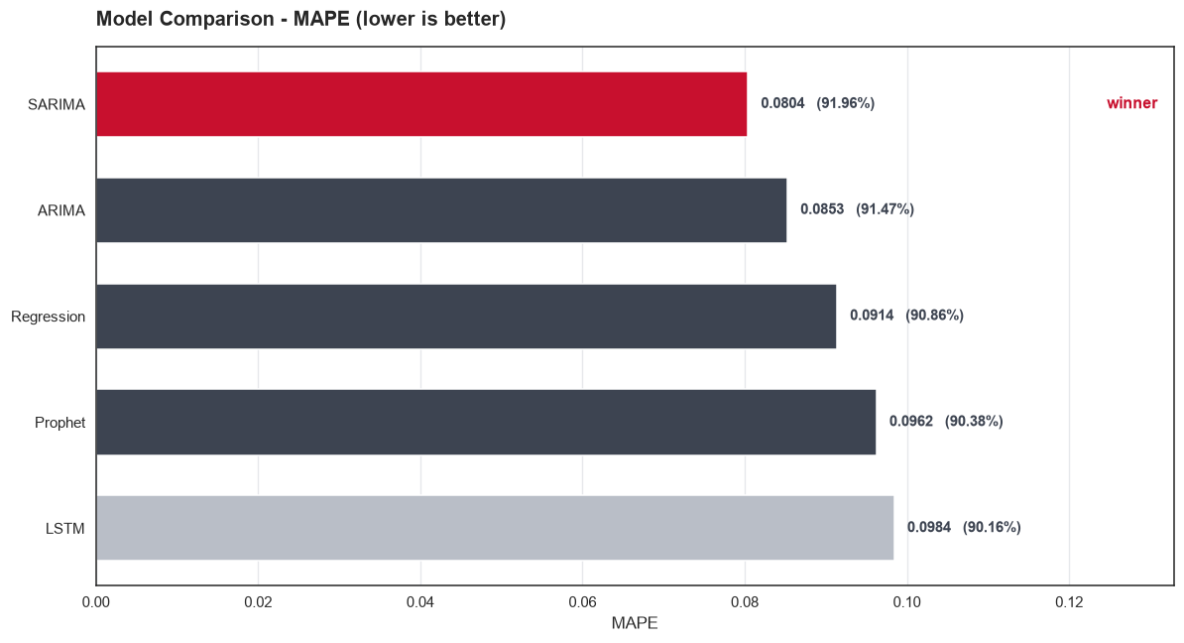
Model Comparison - Results
SARIMA wins; the neural network comes last
MODEL
MAPE
ACC
SARIMA
0.0804
91.96%
ARIMA
0.0853
91.47%
Regression
0.0914
90.86%
Prophet
0.0962
90.38%
LSTM
0.0984
90.16%
THE USEFUL RESULT
40 training weeks is far too little for an LSTM. Classical models encode the right structure directly and win. Sophistication is not suitability.
Domino's - Predictive Purchase Order System
13
Notes:
Spread across all five is under 2 points - the series is well behaved.

Slide 14
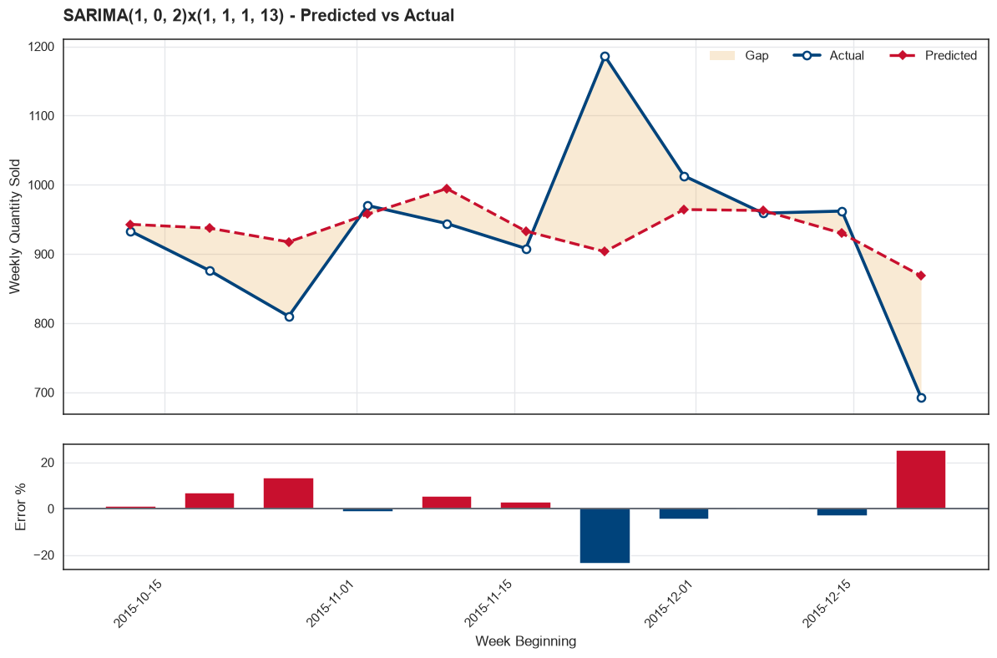
The Winning Model in Action
SARIMA(1,0,2)(1,1,1,13) against the held-out weeks
MAPE
0.0804
91.96% accuracy on weeks the model never saw
Why it won
The only model with an explicit seasonal block. The grid search selected a 13-week period - roughly a quarter - separating trend from season.
Domino's - Predictive Purchase Order System
14
Notes:
Lower panel shows per-week error percentage.

Slide 15
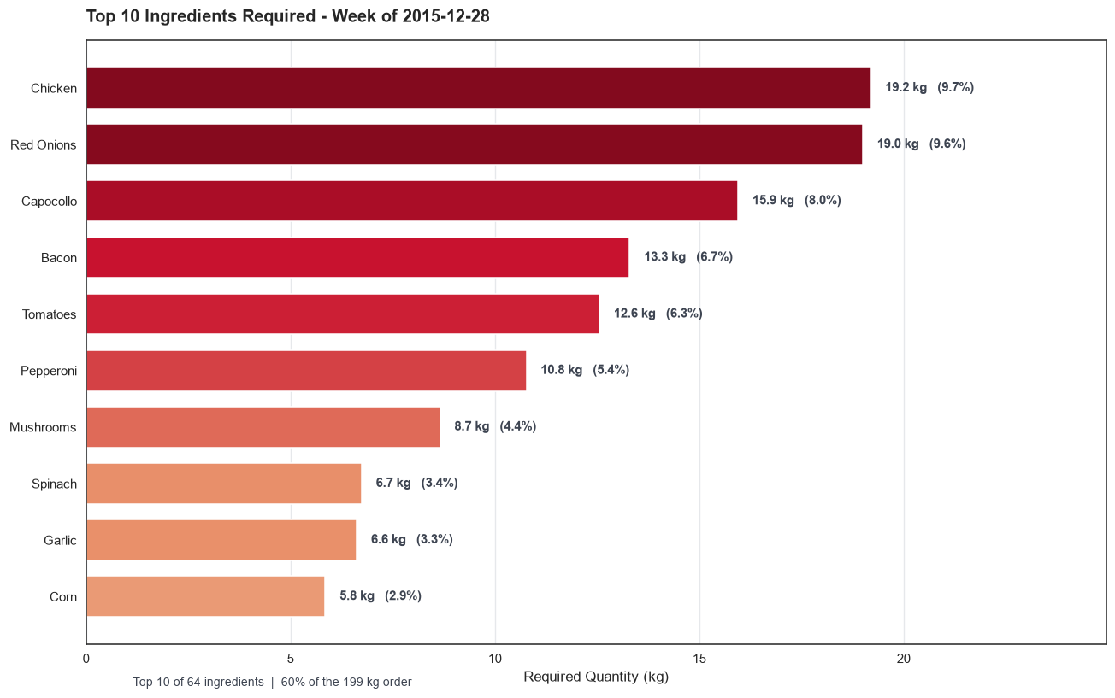
From Forecast to Purchase Order
Three steps to a number a manager can act on
1
Refit on all 51 weeks
2
Forecast 91 variants
3
Multiply through recipes
The split chose the model; the deployed version learns from every week.
One weekly series per pizza_name_id, each predicted one week ahead.
grams per pizza x forecast units, summed by ingredient.
THE ORDER
1,085 pizzas forecast
64 distinct ingredients
198.79 kg total weight
Domino's - Predictive Purchase Order System
15
Notes:
Forecasting per variant is what makes the gram totals correct.

Slide 16
Results
Week of 28 December 2015 - 3 January 2016
91.96%
1,085
64
198.8 kg
Forecast accuracy
Pizzas forecast
Ingredients
Order weight
BUSINESS IMPLICATIONS
Procurement becomes a decision, not a guess
64 ingredients with kilogram quantities a manager can act on directly.
Waste reduction is where the money is
At ~92% accuracy, over-ordering shrinks against ordering by intuition.
Friday, not the weekend, is the operational peak
Staffing and prep should follow Friday; Sunday is over-resourced.
Domino's - Predictive Purchase Order System
16
Notes:
The order translates a statistical forecast into a procurement decision.

Slide 17
Limitations
Stated plainly, because they bound how far this should be trusted
One year of data
Selection used the holdout
Annual seasonality cannot be learned from a single cycle - only weekly and short-range variation.
Hyperparameters were chosen by test MAPE, so 91.96% is mildly optimistic as an estimate of future error.
The forecast week is atypical
No inventory context
28 Dec - 3 Jan spans New Year, and holidays run ~22% above normal. There is no second New Year to learn from.
Assumes zero opening stock, no wastage allowance, no supplier pack sizes or minimum order quantities.
A production system would layer opening stock, wastage allowance and supplier pack sizes on top of this forecast.
Domino's - Predictive Purchase Order System
17
Notes:
Being explicit about limits is part of the deliverable.

Slide 18
CONCLUSION
Raw data in, purchase order out.
The pipeline runs end to end at roughly 92% forecast accuracy - but the most valuable findings were the data problems found on the way.
Dual date format
Truncated weeks
Size-encoded IDs
Would have silently corrupted ~40% of the calendar
Looked like demand collapses at both ends
Determine whether ingredient totals are right
On 51 weeks of well-behaved data, a classical seasonal model beat a neural network - and a plain linear regression came within 1.1 points of the winner.
Thank you
Sai Naveen Pulivarthi
Notes:
Close on the data-quality findings, which generalise beyond this project.

